Slide 1
Quiz Class eco system and methods
Simeon Angelov
Notes:
Hello everyone in the course on:
With me:

Slide 2
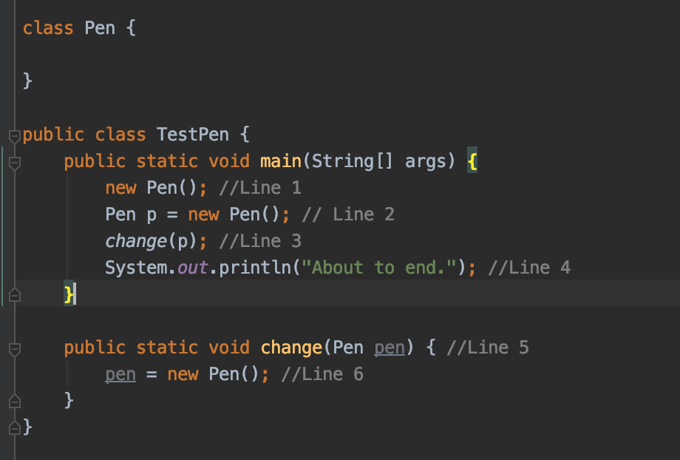
Q1. How many instances of class Pen are eligible for Garbage Collector at line 4?
a) 1
b) 0
c) 3
d) 2
D) 2
Object created at Line 1 becomes eligible for Garbage collection after Line 1 only, as there are no references to it. So We have one object marked for GC.
Object created at Line 6 becomes unreachable after change(Pen) method pops out of the STACK, and this happens after Line 3.
So at Line 4, we have two Pen objects eligible for Garbage collection: Created at Line 1 and Created at Line 6.

Slide 3
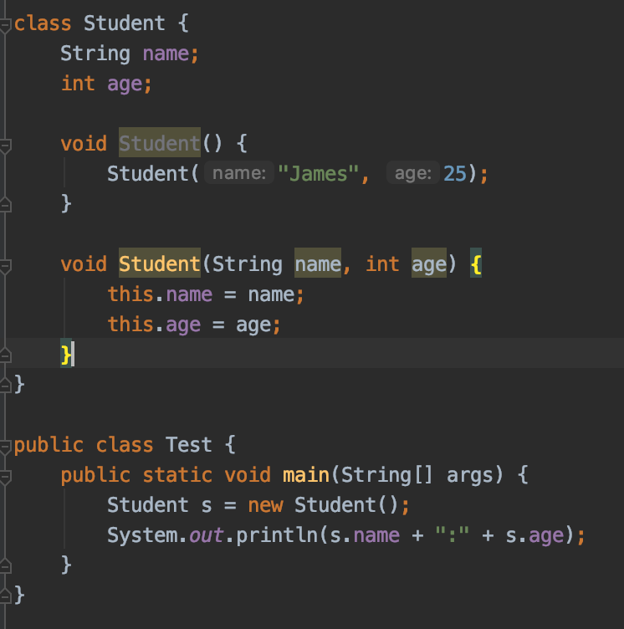
Q2. What will be happened when the code is compiled and executed?
Compilation error
James:25
An exception is throws at runtime
null:0
D) null:0
We do have methods, not constructors here

Slide 4
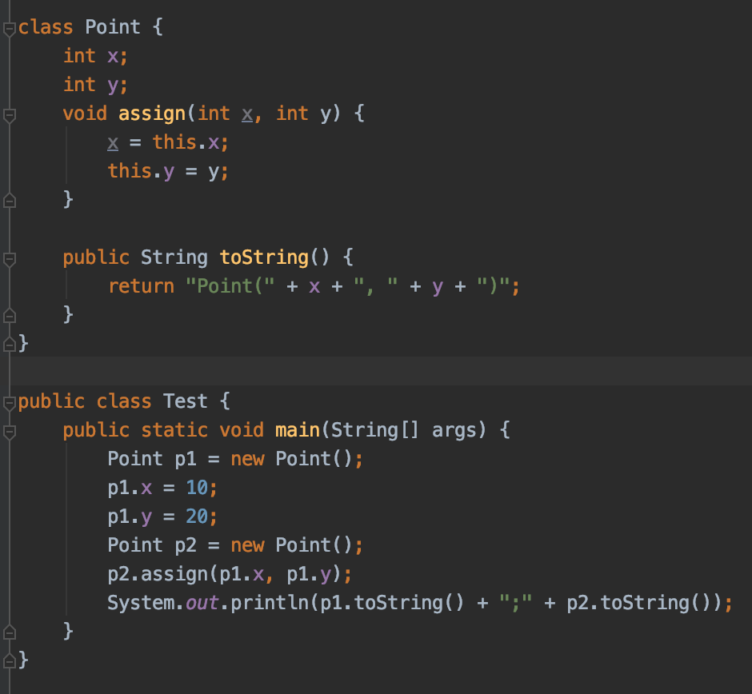
Q3. What will be the result of compiling and executing of Test class
Point(0, 20);Point(0, 20)
Point(10, 20);Point(0, 20)
Point(10, 20);Point(10, 20)
Non of the other options
Point(0, 20);Point(10, 20)
B) Point(10, 20);Point(0, 20)

Slide 5
Q4 Which options are enough to avoid compilation error ?
package orders;
public class Order {
}
package orders.items;
public class Item {
}
package shopping;
/*INSERT*/
public class Shop {
Order order = null;
Item item = null;
}
import orders.Order;
import orders.items.Item;
b) import orders.items.*;
c) import orders.*
import orders.items.*
d) import orders.*
import items.*
c) import orders.*
A) and c)
All the orders will not import Item and Order class

Slide 6
Q5 Which of the following is the correct way to make the variable 'passportNo' read only for any other class?
public class Employee {
public int passportNo; //line 2
}
a) Remove ‘public’ from the ‘passportNo’ decaration
b) Make ‘passportNo’ private and provide a pubic getter e.g. public String getPassordNo(); which will return it’s value
c) Make ‘passwordNo’ static and provide a public static method getPasswordNo() which will return it’s value
d) Make ‘passwordNo’ private
b)

Slide 7
Q6
____________ uses access modifiers to protect variables and hide them within a class.
Which of the following options accurately fill in the blanks above?
Polymorphism
Encapsulation
Inheritance
Abstraction
b)

Slide 8
Q7 What will be the result of compiling and executing of Test class ?
a) >null
>0.0 >0.0f
b) > null >0.0
>0.0
c) > >0.0 >0.0f
d) > >0.0 >0.0
public class Test {
char var1;
double var2;
float var3;
public static void main(String[] args) {
Test obj = new Test();
System.out.println(">" + obj.var1);
System.out.println(">" + obj.var2);
System.out.println(">" + obj.var3);
}
}
d)

Slide 9
Q8 What will be the result of compiling and executing of Test class ?
class Student {
String name;
int marks;
Student(String name, int marks) {
this.name = name;
this.marks = marks;
}
}
public class Test {
public static void main(String[] args) {
Student student = new Student("James", 25);
int marks = 25;
review(student, marks);
System.out.println(marks + "-" + student.marks);
}
private static void review(Student stud, int marks) {
marks = marks + 10;
stud.marks+=marks;
}
}
35-25
35-60
25-25
25-60
d)

Slide 10
Q9 Which of the bellow correctly defines class Printer
a) package bg.newhorizons; ​public class Printer {}
​ b)
public class Printer {
package com.udayan.oca;
}
​ c)
import java.util.*;
package com.udayan.oca;
public class Printer {
}
​ d)
public class Printer {
}
package com.udayan.oca;
a)

Slide 11
Q10. What will be the result of compiling and executing of the code ?
b) Is correct here
class Message {
String msg = "Happy New Year!";
public void print() {
System.out.println(msg);
}
}
public class Test {
public static void change(Message m) {
m = new Message();
m.msg = "Happy Holidays!";
}
public static void main(String[] args) {
Message obj = new Message();
obj.print();
change(obj);
obj.print();
}
}
a) Happy New Year!
Happy holidays!
b)​
Happy New Year! Happy New Year!
​ c)
null Happy New Year!
​ d)
Happy Holidays! Happy Holidays!

Slide 12
Q11. Which of the following can be put in blank so to compile it sucesfull ?
default
final
private
public
String
zzz
public class Hello {
…….. void hey() {}
}
b) Final define the method is not changbale/overridable in sub classes
c) Private
d) public

Slide 13
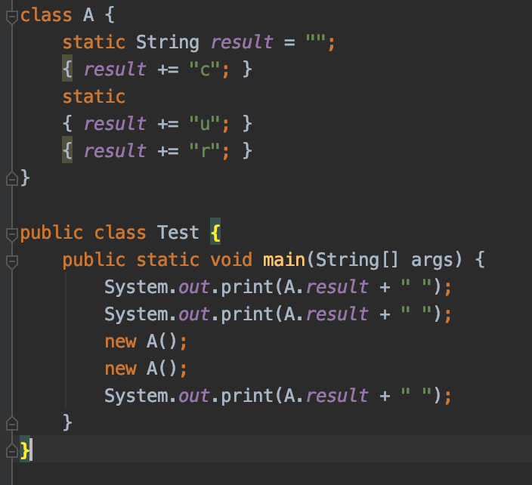
Q12. What is the result of compiling and executing of the code?
a) curur
b) ucrcr
c) u ucrcr
d) u u curcur
e) u u ucrcr
f) ur ur urc
g) The code does not compile
e) remember sequence of execution – statis blocks first and they are called only one time

Slide 14
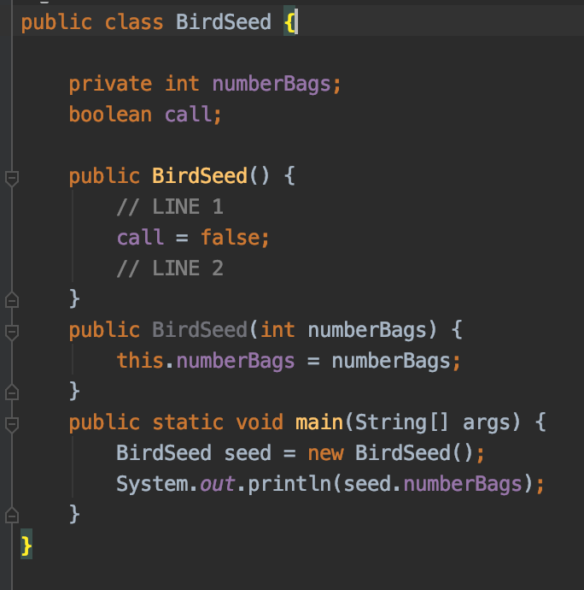
Q13 Which code can be inserted to have the code print 2?
a) Replace line 1 with BirdSeed(2);
b) Replace line 2 with BirdSeed(2);
c) Replace line 1 with new BirdSeed(2);
d) Replace line 2 with new BirdSeed(2);
e) Replace line 1 with this(2);
f) Replace line 2 with this(2);
e)

Slide 15
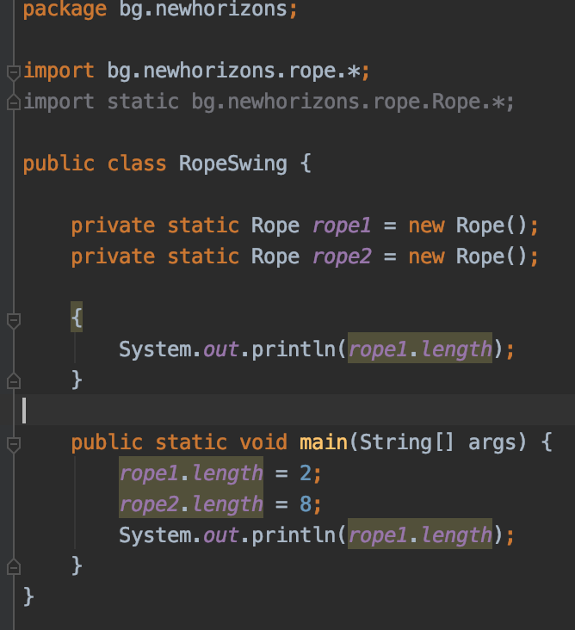
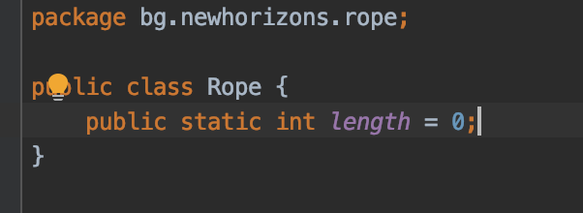
Q14. What is the output of the following code?
01
08
2
8
Compilation error
Exception error
d)

Slide 16
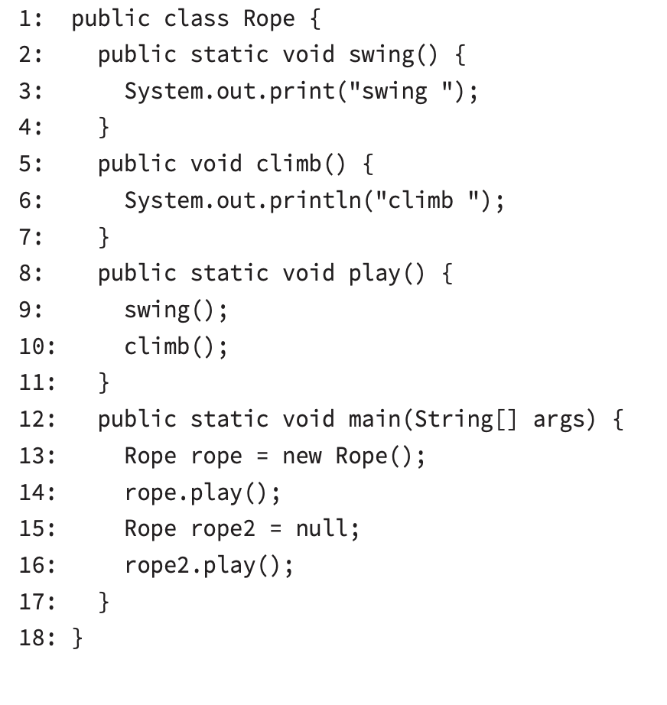
Q15 Which are true in the following example ? (Chose all apply)
a) The code compiles as is
b) There is exactly one compiler error in the code
C) There are exactly two compiler errors in the code
D) If the lines with compiler errors are removed, the output is climb climb
E) If the lines with compiler errors are removed, the output is swing swing
F) If the lines with compile errors are removed, the code throws a NullPointerException.
b) one compilation error f) swing swing

Slide 17
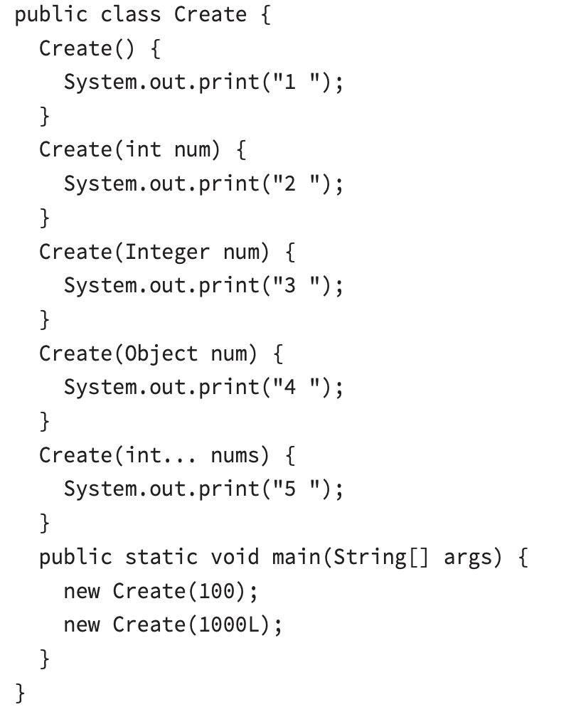
Q16 Which of the following are true for the code bellow?
The code prints out 2 4.
b) The code prints out 3 4.
c) The code prints out 4 2.
d) The code prints out 4 4.
e) The code prints 3 4 if you remove the constructor Create(int num)
f) The code prints 4 4 if you remove the constructor Create(int num)
g) The code prints 5 4 if you remove the constructor Create(int num)
a) 2, 4

Slide 18
Thank You For Your Time

